Slide 1
Impacts of Oil Prices on Saudi Arabian Economy
Name:
Professor:
Course Title:
Institution:
Date:

Slide 2
Impacts of Oil Prices on Saudi Arabian Economy

Slide 3
Introduction
Saudi Arabia is a Middle East Country, a member of Organization of the Petroleum Exporting Countries(OPEC) and Gulf Cooperation Council(GCC) and world’s largest oil exporter.
Its economy is highly dependent on revenues from oil.
This implies that oil prices have various effects on the country’s economic sectors.
Some of the economic aspects affected : economic growth and GDP, current, and stock accounts, monetary and fiscal policies, revenues from exports, and even the employment sectors to mention but a few.

Slide 4
Factors Contributing to Price Changes
Oil is one of the most important factors in production affecting all economic sectors either directly or indirectly.
The prices of oil may vary due to the following reasons:
  The world economic growth rate –an increase in this rate results in increase in prices.
  The market forces of demand and supply- an endogenous relationship exist between the forces and oil prices.
  Economic stability- weak economy leads decrease in prices due to decrease in demand
  Slumps or shortage in production –slumps decrease the prices while shortages increase the prices.

Slide 5
Impacts on GDP
Oil revenues contribute to over 40% of the GDP.
In 2000, the overall growth rate in this oil-rich country was by 5.6%, and by 2008 it had recorded growth increases.
Remarkably, the GDP had gone up by 6.3%, thanks to the oil prices that had maintained a steady increase.
Increasing oil price result in high GDP and the converse is true.

Slide 6
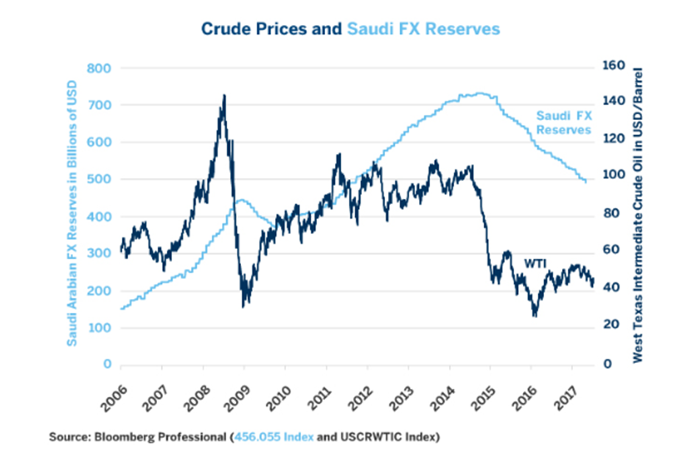
Impacts on Fiscal and Monetary Policies
Changes in the prices of oil have made Saudi to structure countercyclical fiscal policy, to enable it to survive plunges in the oil prices.
It is during the times when the prices are high that the country accumulates reserves to diversify the economy and prepare for economic crises in the case that a decline occurs.
The government has to increase its budget deficit and spend more of its reserves in the event that there is a oil price crisis.
In the case of a plunge, the government has to adopt strict monetary policies to guard the financial markets.
Recent plunges include a likely deterioration in the fiscal balances due to a reduction in subsidies, adoption of a more diverse economic portfolio, and enhancement of state revenue through taxation.
.

Slide 7
Impacts on Inflation
Sharp declines in the prices of oil may result into disinflation. This results into several impacts:
Macro-finance and microfinance firms to adopt emergency policies.
The central bank has to stabilize the output gap to reduce the volatility of the prices and the wages too.
Foreign exchange rates depreciation which have to be implemented in an informed manner.
Increase in prices results in the subsequent increase in the rate of inflation.

Slide 8
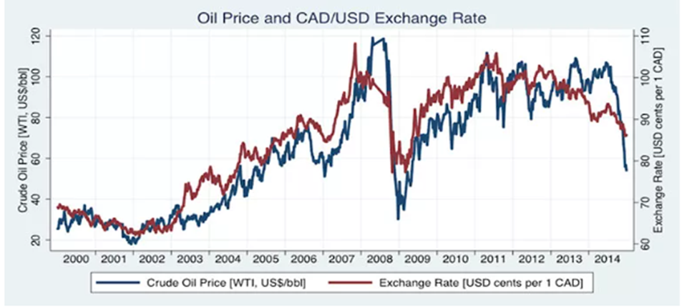
Impacts on Financial Markets
Financial markets are volatile and respond to the slightest disruptions within the economy.
Transactions in the oil trade rely on the dollar as the base currency.
An increase in the prices of oil leads into the subsequent increase in the strength of the dollar and a rise in the transactions demand.
When the exchange rates for the dollar are high, the importing countries suffer higher debt costs.
In the long run the quantity demanded of oil is affected as well as the financial market whereby the equity values and exchange rates still fluctuate even in the event where monetary policies are in place(Arouri,2009).
In the case of price decline the government has to liquefy the petrodollar to shield the financial markets.

Slide 9
Impacts on Economic Development Strategy
High oil prices promote government expenditure and the marginal propensity to save is also high.
This means that more funds are directed towards the improvement of the existing economic sectors.
Sharp falls in the prices of oil highlight the gaps in the economy specifically the vulnerabilities that the country is exposed to by extremely relying on oil revenues.
This challenges the development strategies towards implementing diverse programs.
The implication is that rigorous efforts and incorporation of proactive measures have to taken.
Specifically, subsidies and incentives have to be redirected to other sectors of the economy other than the nontradable and public sector employment (Gill et al. 2014; Cherif and Hasanov 2014a and 2014b).

Slide 10
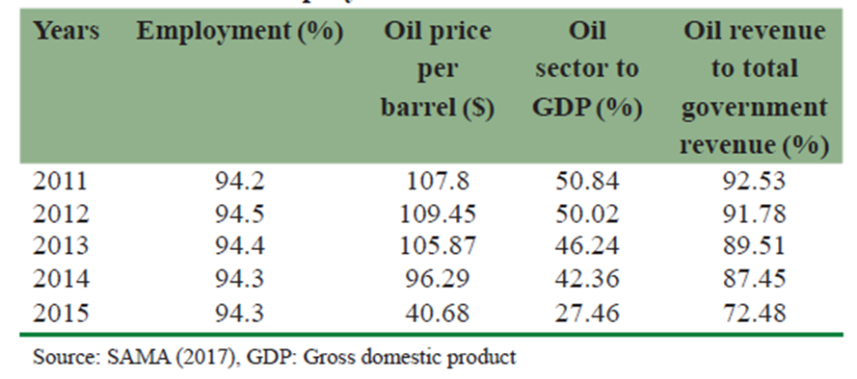
Impacts on Service Industry and Employment
Price increases have led to the growth and development of the service industry since surplus earning have made monetary expansion possible.
Declines in the oil prices result to a great decline in the size of investments within the petroleum sector, and subsequently, in economic growth as well as deterioration in the employment sector.
Price declines in Saudi have great impacts on the poor in the long-run since stricter monetary policies are put in place to prevent losses and recessions(Nazer,2016).

Slide 11
Conclusion
Changes in oil prices have great impacts on the economy of Saudi.
The prices are driven by different factors.
Price increase and decrease have different impacts on the economy.
These impacts have to be controlled hence the influence on both monetary and fiscal policies.
Saudi is highly reliant on oil for the funding of its budget there changes in oil prices mean changes in every aspect of economy.

Slide 12
References
Gill, I. S.; I. Izvorski; W. van Eeghen; D. de Rosa. 2014. “Diversified Development: Making the Most of Natural Resources in Eurasia.” Europe and Central Asia Studies. Washington, DC; World Bank Group.
Nazer, Y. (2016). Causes of inflation in Saudi Arabia. The Business & Management Review, 7(3), 147.
Arouri, M.E.H., & Fouquau, J. (2009). On the short term influence of oil price changes on stock markets in GCC countries: linear and nonlinear analyses. Journal of Economics Bulletin, 29, 795-804.
SAMA. (2012), Forty Eight Annual Report, Research and Statistics Department, Riyadh.

